Slide 1
MPPT solar PV System for GRID AND EV charging
TEAM - pranay1615_2b37
MEMBERS - Pranay Kumar ( LEADER )
Aditya Prakash
Om Shiv Keshri
COLLEGE - VELLORE INSTITUTE OF TECHNOLOGY

Slide 2


PROBLEM STATEMENT
Sub Theme – Sustainable Society ( Effective utilization of energy )
Statement –
To develop a Grid connected MPPT Integrated solar PV System for electric vehicle charging and Battery Management.
There is Lack of support for grid development to cater to the increased load.
EV customers currently face various financing challenges.
Lack of affordable renewable energy means charging EVs that is weighing in on the already stressed electricity grid that runs on coal.
Uninterrupted charging still remains a concern in Indian market.

Slide 3
SOLUTION
There is no denying the industry has made progress but its infrastructure is neither scalable nor sustainable and profitable.
The main idea of our project is divided into two major parts :
The first part majorly focuses on drawing maximum power from solar PV array .
After extensively going through various research paper we have decide to choose Incremental Conductance method for our application.

Slide 4
The second part of our project focuses on efficient utilization of power drawn from PV array .
There is a Switch to regulate the flow of power into two separate subsystem as show in the figure in the next side.
If there is no electric vehicle attached to the charging system , then the power could be diverted to be delivered to the Power Grid. Solar Inverter convert DC power to AC power with MPPT.
The Voltage obtained from Solar Inverter is passed through LC filter and finally delivered to the Grid.

Slide 5
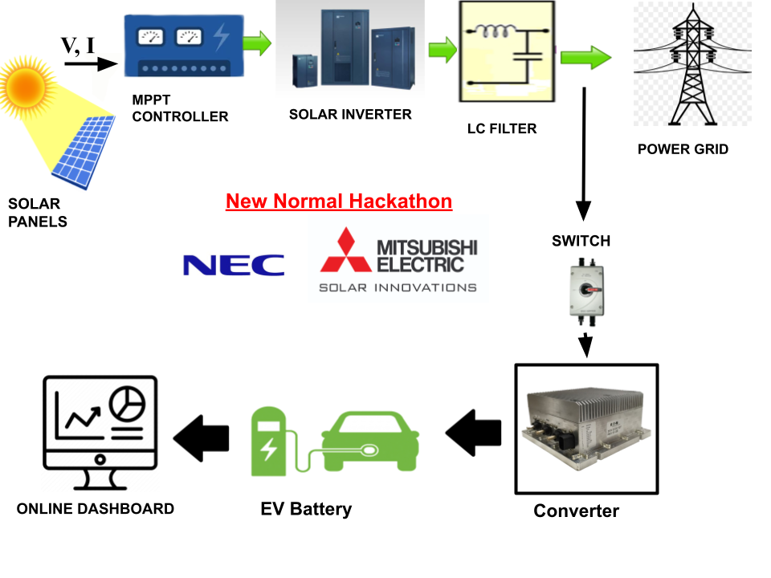
Block Diagram of the Model:

Slide 6
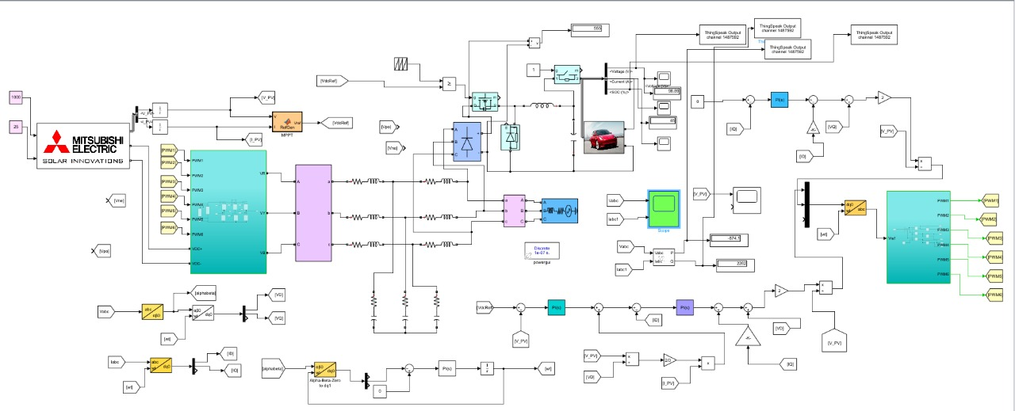
DEMO MATLAB SIMULINK

Slide 7
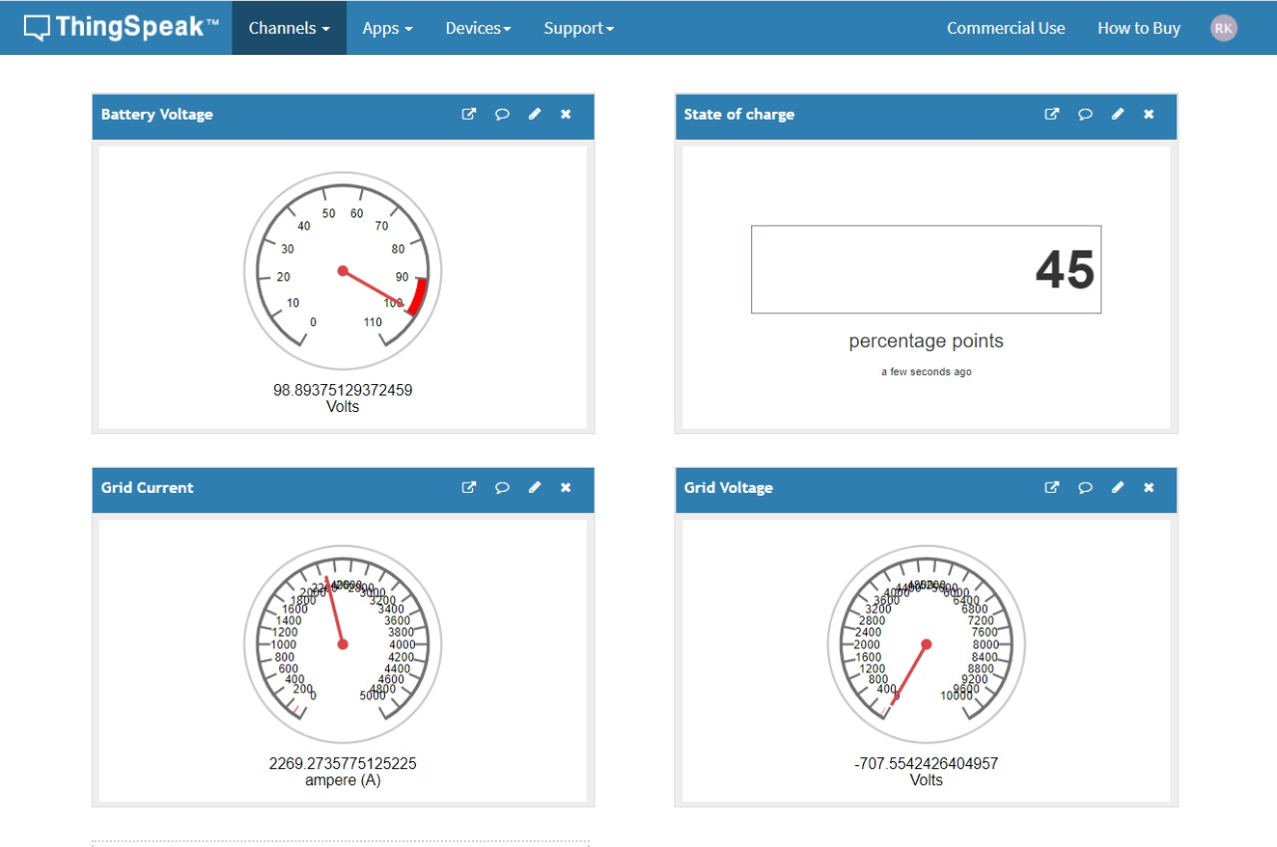

Slide 8
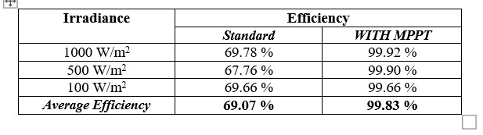
Tracking EFFICIENCY OF SYSTEM

Slide 9
IMPACT TO SOCIETY
Driving fuel-based cars can burn a hole in your pocket as prices of fuel have gone all-time high.
The biggest advantage of an electric vehicle is its green credential. Electric cars are 100 percent eco-friendly as they run on electrically powered engines.
It is nearly three times as efficient as cars with an internal combustion engine, according to Wikipedia

Slide 10
Electric cars run on electrically powered engines, and hence there is no need to lubricate the engines with very low maintenance cost.
With the improving technologies, the cost of these batteries is expected to come down even more.
With a good battery management system people will attract more towards EV.
India can become potential supplier of EV to other countries. Gradually increasing GDP of India economy.
Most industry analysts agree that upgrades are needed to the transmission grid to handle the increased load from EVs.

Slide 11
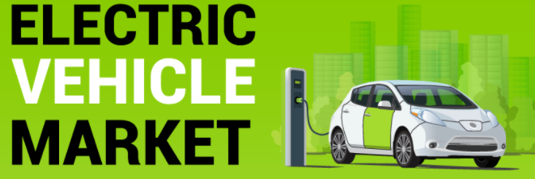
MARKET SCOPE
Indian renewable energy sector is the fourth most attractive renewable energy market in the world.
The government is aiming to achieve 227 GW of renewable energy by 2022, more than its 175 GW target as per the Paris Agreement.
As per a Market Watch report, India would need around 4 lakh charging stations to accommodate the demand for 20 lakh EVs on the roads by 2026.

Slide 12
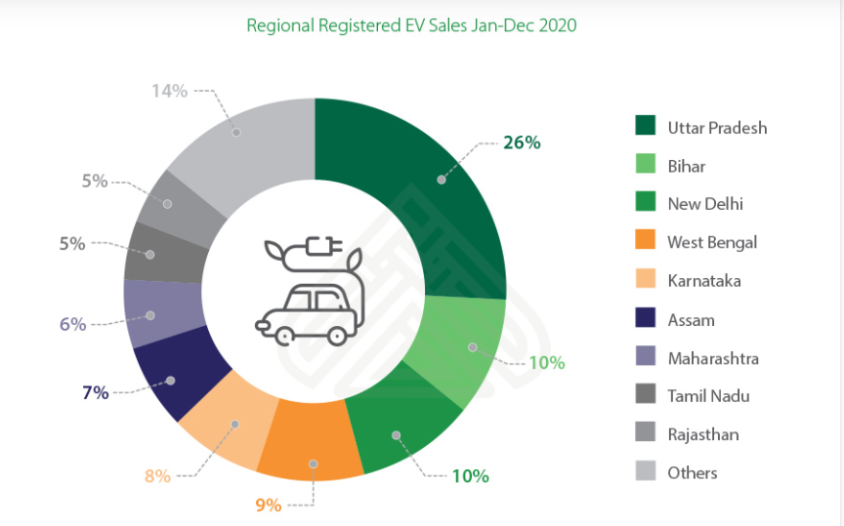
Bonus Fact **** Use of renewables in place of coal will save India Rs. 54,000 crore (US$ 8.43 billion) annually. Renewable energy will account for 55% of the total installed power capacity by 2030.

Slide 13
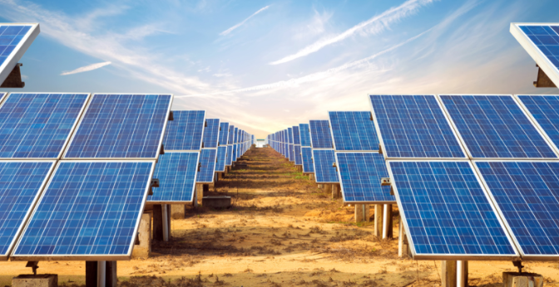
FUTURE SCOPE
EV market has a great scope in future and is growing exponentially in India.
Many Indian companies like : Tech Mahindra, Tata Motors, Ashok Leyland and OLA has started working over it.
This also promotes concept of Renewable energy resources use and reduce pollution.
The Government of India targeted to install renewable energy capacity of 175 GW by the end of 2022.
At the United Nations Climate Action Summit, Prime Minister of India Narendra Modi announced the renewable energy target to 450 GW by 2030 from 175 GW by 2022.

Slide 14
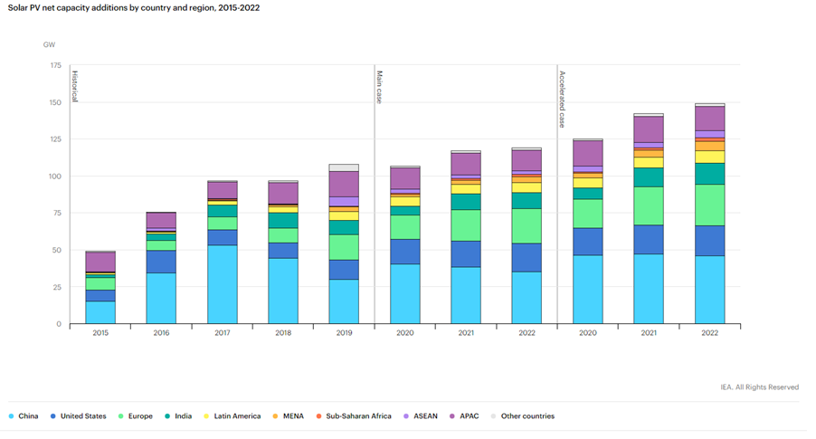
World comparison
In 2020, utility-scale additions will increase nearly 3% owing to record additions in the United States.
China is has constructed over 33% more PV capacity than in 2019.

Slide 15
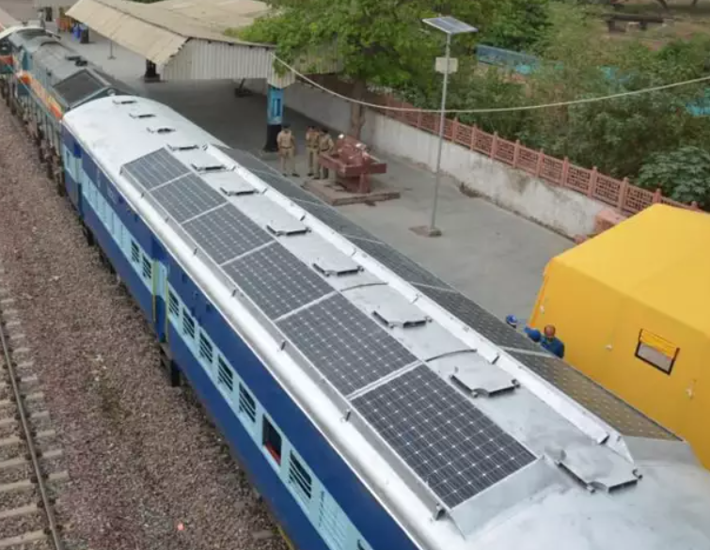
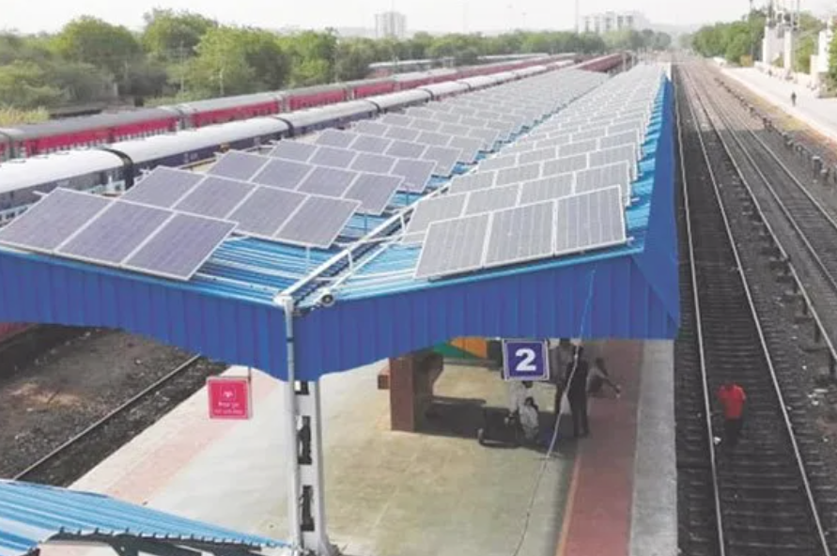
HOW India incorporated solar power
Solar powered railways

Slide 16
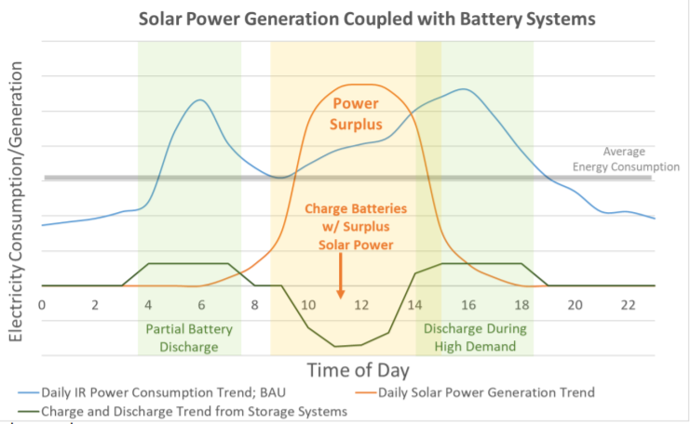
This will help Railway’s mission to achieve the goal of becoming “Net Zero Carbon Emission Railway” before 2030.
IR consumed 2.6 billion liters of diesel in 2015

Slide 17
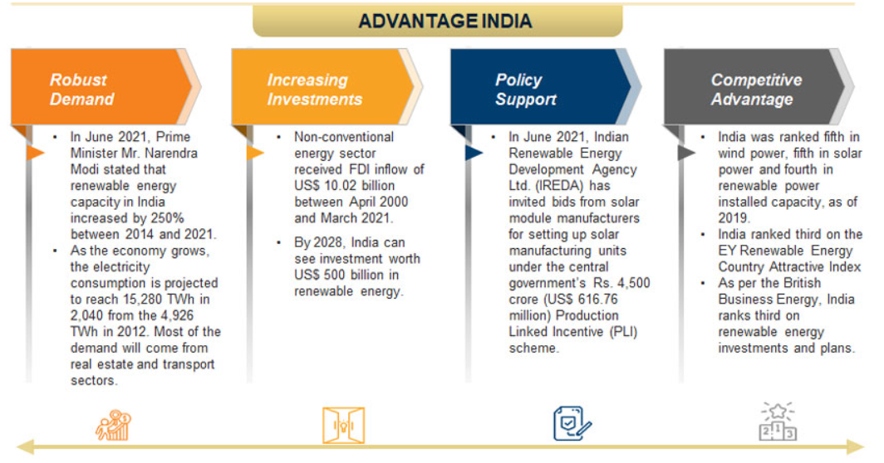
In India, for example, trains have solar power on their roofs and in 2017, the city of Guwahati became host to the first station in the country to be 100% solar-powered.

Slide 18
References
“A New VSAS approach for Maximum Power Tracking for Renewable Energy Sources (RES)” Nacer K. M’Sirdi , Abdelhamid Rabhi , Mouna Abarkan
"PV Power System Using Maximum Power Point Tracking (Increment Conductance Algorithm)” Vol. 3, Issue 5, May 2014 @IJIRSET, Mohammed Ali Khalifa, Kamal Mohamed Saied,Sami Salem Bitro, Miftahul Anwar, Muhammad Nizam
“New perturb and observe mppt algorithm and its validation using data from pv module” @IJAET, Bikram Das ,Anindita Jamatia, Abanishwar Chakraborti Prabir Rn.Kasari& Manik Bhowmik
“Analysis of Different MPPT Techniques” Vol. 5, Issue 3, March 2
016 @IJAREEIE, Athira B,. Greeshma V,. Jeena Johnson
“A New Maximum Power Point Tracking for Photovoltaic Systems” Mohamed Azab, International Journal of Electrical, Computer, Energetic, Electronic and Communication Engineering Vol:2, No:8, 2008.
“Enhancement of Solar Photovoltaic Cell by Using Short-Circuit Current Mppt Method” Burri Ankaiah, Jalakanuru Nageswararao @ www.ijesi.org Volume 2 Issue 2 ǁ February. 2013 ǁ PP.45-50

